Slide 1

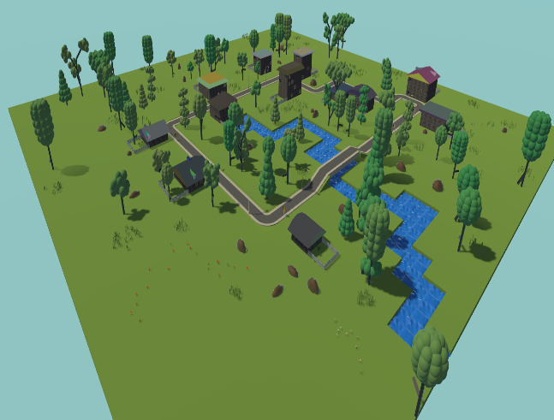
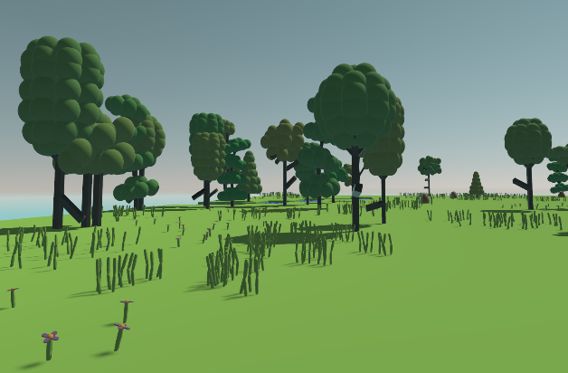
Procedural Generation of Game Assets.
Brian O’Neill
Introduction
Methods
Results
Conclusions
I plan to create an editor
using Unity3D that has the ability to create roads using a directional tool that will create the road in the direction chosen. You will be able to choose between two types of roads and then as you are creating the roads, other objects such as lamp posts and buildings will spawn as you move along. With the editor you will be able to create objects around the scene. These objects include trees, rocks and grass. All the objects will be created at runtime using different algorithms. Using procedural generation, I aim to create a small slice of a game world.
To create the roads, I will be using a directional tool to decide the angle the player wishes to go and then by using an algorithm to create the road in the desired direction. For the creation of the trees and the grass I implemented my version of a Lindenmayer System [1]. The buildings are generated using an algorithm to create the structure and the roof is made using procedural mesh generation. The rocks are created by taking a simple sphere mesh and by applying the Perlin noise texture generator [2].
Using my editor I have created a small slice of a game world. As you can see in the image below, no two pieces are exactly the same. These algorithms are used to produce similar but noticeably different environments.
From the results, I can conclude that procedural generation can be an extremely effective tool for developers, particularly in creating worlds with varied environments. This allows for less time to be spent on handcrafting these worlds.
Bibliography
L-Systems [1]
Perlin Noise [2]

